Slide 1
Welcome
Ethnography literally means 'a portrait of a people
Ethnography literally means 'a portrait of a people

Slide 2

ETHNOGRAPHIC RESEARCH DESIGN
Dr. GEETHA GOPINATH
ASSISTANT PROFESSOR
DEPARTMENT OF EDUCATION AND EDUCATIONAL TECHNOLOGY
SCHOOL OF SOCIAL SCIENCES
UNIVERSITY OF HYDERABAD
CENTRAL UNIVERSITY CAMPUS
HYDERABAD

Slide 3
CONTENTS
Ethnography--meaning
Key features of Ethnography
Steps of Ethnographic Design
Types of Ethnography
Skills required for conducting Ethnography
Ethical guidelines of the design
Strengths and weakness of Ethnographic design

Slide 4
learning OBJECTIVES
Enable the student teachers to,
define the concept of Ethnographic research Design
describe the key features of Ethnographic research
explain the skills needed in Ethnographic research
enumerate the steps of Ethnographic research
elucidate different types of Ethnographic research
analyze the strengths and limitations of Ethnographic research

Slide 5
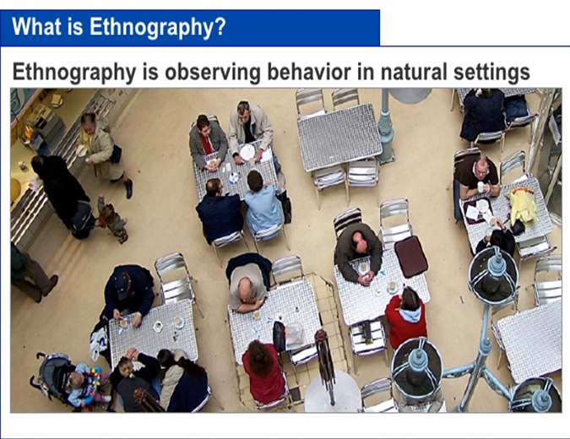
Ethnographic research design is
a qualitative research method where
researchers observe and/or interact
with participants in their real-life
environment. The aim of the design
is to get 'under the skin’ of a problem
and its associated issues in order to
produce a detailed and comprehensive
account of a social phenomena

Slide 6
What is Ethnography?
Ethnography can be briefly defined as the systematic study of people and cultures.
It is designed to explore cultural phenomena where the researcher observes society from the point of view of the subject of the study.
It is a means to represent graphically and in writing the culture of a group.
Ethnography is a qualitative research method where researchers observe and/or interact with a study’s participants in their real-life environment.
It was initially popular in the field of anthropology, but is now used across a wide range of social sciences.
A good researcher is required when observing and/or interacting with target audiences in their real-life environment.
Ethnographic studies are usually conducted through interviews, participant observation and surveys.

Slide 7
ETHNOGRAPHY-MEANING
Ethnography research is an approach that focuses on a setting, a group of people and uses the concept of culture as a lens through which to interpret results
(LeCompte & J. Schensul, 2010).
Ethnographers study human cultures and societies by living among the people they study, by immersing themselves within the subject group
The ethnographer participates as much as possible while observing, taking detailed notes, developing an ongoing analysis from the notes and compiling a report about the findings.
The relationships between researcher and researched are considered to be an essential element of an ethnographic study.
There is active sharing of knowledge between research participants of a culture and ethnographers participating within it

Slide 8
When do we use ethnography?
While searching for the meanings of cultural norms and views
In trying to understand the reasons for the use of certain behavior or practices
For examining social trends and instances like divorce, illness, migration, cultural belief, media usage etc
For examining social interactions and encounters
To understand the roles of families and organizations and their behaviour
To identify new patterns and gain new insights into social phenomenon
To understand the hygiene and sanitation practices of communities
To observe the types of punishment given to children at school
To study the behaviour of workers in an organization

Slide 9
Key Features of ethnographic design
Usually focus on very few cases, maybe just one, but in detail
Often involve working with previously unstudied phenomenon
Emphasize on exploring social phenomena rather than testing of preset hypotheses
Focus on describing the culture of a group in very detailed and complex manner
Involve engaging in extensive fieldwork where data collection is mainly by interviews, symbols, artifacts, observations, and many other sources of data
Field-based and is conducted in the settings in which real people actually live, rather than in laboratories where the researcher controls the elements of the behaviors to be observed or measured.

Slide 10
Key Features of ethnographic design
A holistic approach to the study of cultural systems
A process of discovery, making inferences, and continuing inquiries in an attempt to achieve maximum validity
An open-ended emergent learning process, and is highly flexible and creative process
Interpretive, reflexive, and constructivist process
Requires the daily and continuous recording of field notes
Tries to earn trust of the respondents

Slide 11
STEPS OF ETHNOGRAPHIC METHOD
Selection: The ethnographic method begins with selection of a culture. The researcher selects the culture/ community or population according to his or her interest.
Review of Literature: Then the researcher reviews the literature pertaining to the culture to get a brief idea and historical sketch of the culture selected for study.
Identification of variables: The researcher then identifies variables which interests him or her as well as the members of the culture and needs to be explored.
Entry: The ethnographer then tries to enter the culture and gain the acceptance of the members of the culture
Cultural Immersion: Ethnographers live in the culture for months or even years which they have chosen to study. The middle stages of the ethnographic method involve gaining informants, using them to gain yet more informants in a chaining process

Slide 12
STEPS OF ETHNOGRAPHIC METHOD
Data Collection: After gaining the confidence of the respondents, the researcher collects information in form of observational transcripts and interview recordings and tapings
Analyses of Data : From the many sources collected, the ethnographer analyzes the data for a description of the culture-sharing group, themes that emerge from the group and an overall interpretation. The researcher begins to compile a detailed description of the culture-sharing group, by focusing on a single event, on several activities, or on the group over a prolonged period of time.
Generalizations; Forge a working set of rules or generalizations as to how the culture-sharing group works as the final product of this analysis. The final product is a holistic cultural portrait of the group that incorporates the views of the participants (emic) as well as the views of the researcher (etic).

Slide 13
TYPES OF ETHNOGRAPHIC RESEARCH
Macro ethnography: It is the study of broadly defined cultural grouping such as – “eco-friendly practices of tribes in India”. The common perspectives are studied at a more larger level, which are found to be common under a more broader strata.
Micro ethnography: It is the study of more specific cultural groupings such as the “religious practices of tribal people in kerala”.
Emic perspectives: It is the ethnographic approach under which the viewpoints and responses of the ‘ingroup’ or the members of the culture understudy are noted down
Etic perspective: It is the ethnographic approach under which the viewpoints and responses of the ‘out groups’ or the members who do not belong to the culture under study are noted down. Their viewpoints highlight the phenomena being followed under a particular culture

Slide 14
Skills required for Ethnographic Studies
High degree of interpretative agility is required to understand the wide range of issues and facts involved in the study.
The researcher needs to be unbiased and unprejudiced in order for the study to draw valid and reliable conclusions
.The researcher needs to be familiar with the social settings and needs to have a high degree of intellectuality and diplomacy.
The researcher needs to possess good interactional and inter-personal skills.
The researcher needs to be sensitive towards the culture, values and norms of the social setting in which the study is being conducted.
The researcher needs to be familiar with the tenets of research ethics

Slide 15
Ethnographic design--Do’s
Have an open mind, free of any kinds of prejudice or biasness
Keep a simple stature so that the people feel comfortable and act naturally
Be diplomatic and supportive towards the views and opinions of the subjects
A prior study and understanding of the group and the environment is vital for a good ethnographic study
Good understanding of social science theory, research methods and research design is important for conducting ethnographic studies
Think about what you are going to ask beforehand and get familiar with the questions
During an interview try to put your respondents at ease and choose a setting where your interviewee will feel safe and comfortable
Conduct the study in a relaxed and stress free mood
Always keep in mind to respect the ethics and norms of the group under the study

Slide 16
Ethnographic design--Don’ts
Do not interrupt and simply observe
Never put pressure on the study subjects
Do not offend the culture, values and norms of the group under study
Do not over dress and keep the actions limited
Never distort the facts to meet the research aim
Never go unprepared and without prior understanding of the group
Never cross the ethical boundaries to conduct the research

Slide 17
Strengths of ethnographic design
First hand insights--As the researcher has interacted, experienced as a participant and observed with the participants firsthand, they can be sure of the insights that surface reliably.
Detailed data--The length of the time spent with the participants, probing and observations lead to rich and detailed data collection.
High reliability--Because the researcher is directly engaged with the group participants and immersed into the group, the data collected is not from external or from individuals outside of the group under consideration. The data collected is highly reliable.
Close-interaction--The ethnographic researcher is a participant within a group or culture, and involved closely with the other participants, they can develop perceptions, which can give them a peek into the lives and experiences of the participants within their culture. This also helps the researcher gain a deep understanding of different perspectives of individuals.

Slide 18
Weakness of ethnographic design
Time-consuming--A good ethnographic research study will require a huge time commitment from the researcher’s end. For studies that can go on for years at a stretch, researcher needs to stay part of the group for a long time.
Diversity of results--The large number of participants and the extended exposure to their thoughts, preferences, cultural backgrounds and behavior can generate large amounts of diverse data which can pose a challenge to collate.
Reliability--As the researcher is solely involved in the group, it’s difficult to validate the reliability of data collected and insights generated.
Researcher Bias--As the researcher is engaged first hand with the other participants being studied, they are likely to introduce bias.
Participant reservations--If the role of the researcher is well known to the group participants, they may not always be open to sharing their perspectives.

Slide 19
Summary
Ethnography is a qualitative research method where researchers observe and/or interact with a study’s participants in their real-life environment. It is a systematic study of people and cultures. It is a means to represent graphically and in writing the culture of a group. It is designed to explore cultural phenomena where the researcher observes society from the point of view of the subject of the study..

Slide 20
Suggested readings
Hammersley, Martyn, & Atkinson, Paul (1995). Ethnography: Principles in Practice, Second Ed .London: Routledge.
Neuman, W. L. (1994). Social Research Method: Qualitative and Quantitative Approaches (2nd ed.). Bostin: Allyn & Bacon.
Kothari,C.R. (2008). Research Methodology Methods and Techniques (second revised edition). New Delhi: New Age International.
McMillan, J. H. & Schumacher, S. (1993). Research in Education: A Conceptual Understanding. New York: Haper&Collins.
Punch, K. (1998). Introduction to Social Research: Quantitative and Qualitative Approaches. London: Sage

Slide 21
THANK YOU……

